Slide 1

Journalism Automation
Awanish Tiwari
Divya L
Rameshwar Gupta
Rohit Lakshminarayan

Slide 2
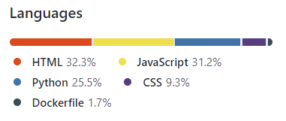
Introduction
Automation team mainly focuses on automating most of the steps carried out within the Journalism ecosystem to make the process simpler in assigning stories based on the journalist's availability, notifying the editors on completed stories to review, and further sending for approval to publish contents and other process involved.
We are utilizing couple of new establishments and technologies to produce such a solution. Several new technologies and tools incorporated are as below:
Node-red
FSM
MS Teams
Gmail
HTML - CSS
Angular JS
MongoDB
Docker
Heroku
Git

Slide 3
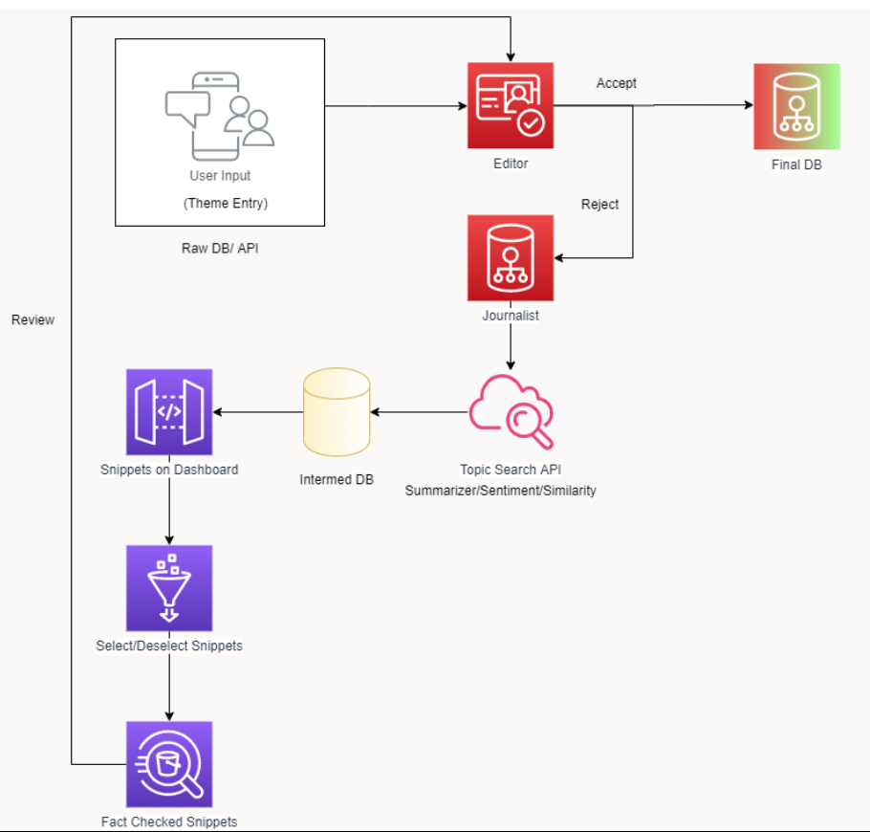
Project Architecture

Slide 4
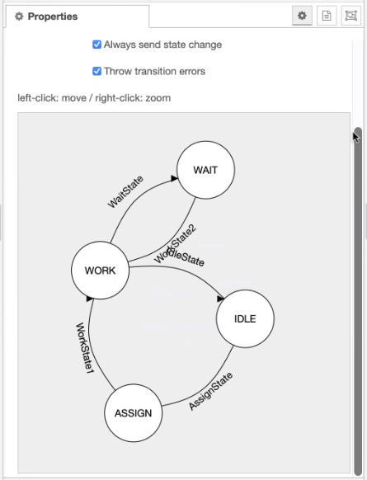
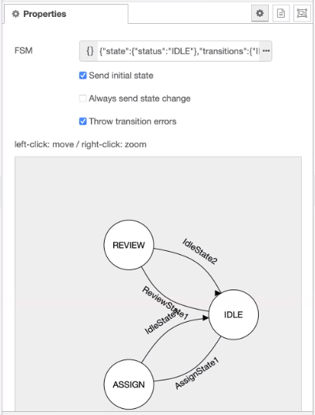
FSM
Journalist FSM
Editor FSM

Slide 5
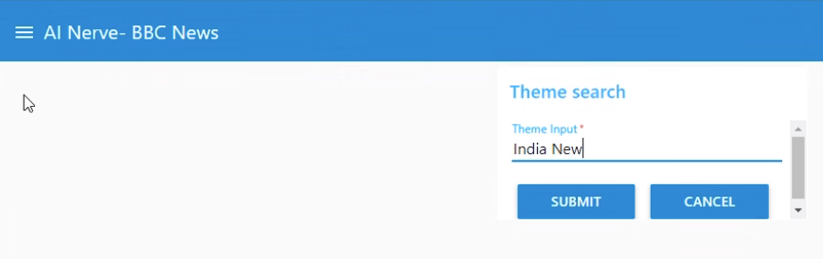
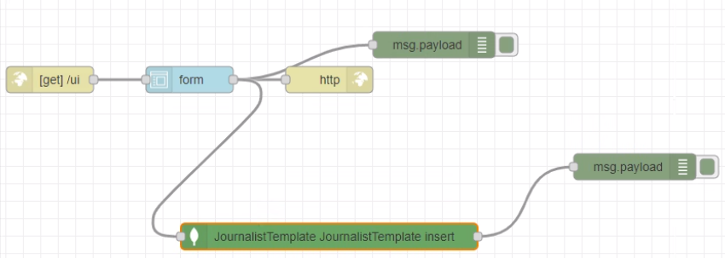
Theme Search
Sponsor or Editor is having the privilege to Key in the Theme he/she would like to have the final snippet or information on.

Slide 6
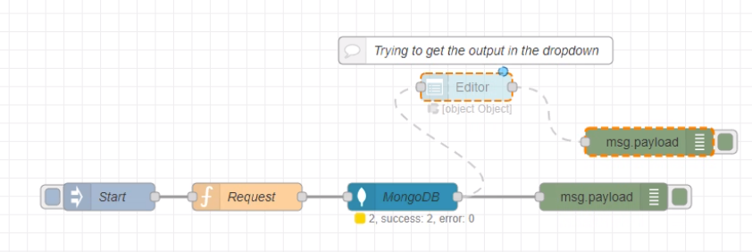
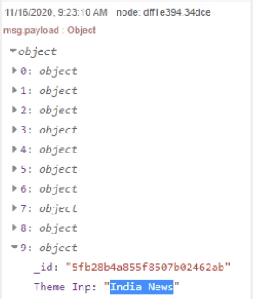
Theme Retrieval
The Theme inserted into MongoDB needs to be retrieved back on the screen so that it gets assigned to Journalist and the Journalist start working on it and produce story/topic snippets on it.

Slide 7
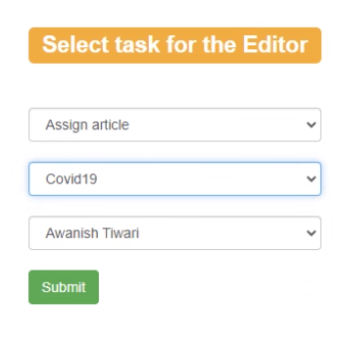
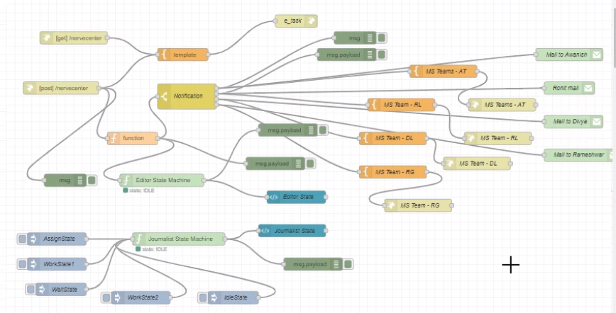
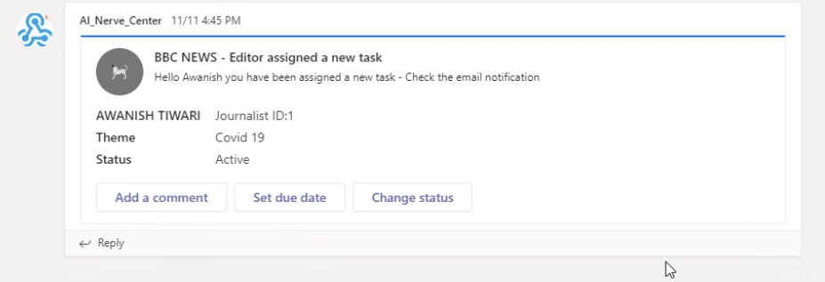
Teams Notification
Editor fetches the pre-inserted theme topics and assign to Journalist to work on that theme and share the Topics and Topic Details for review.

Slide 8
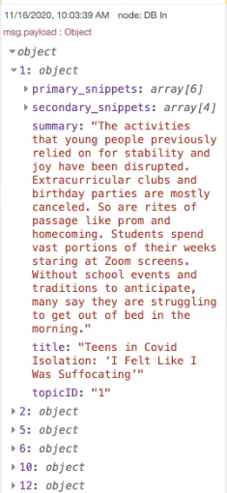
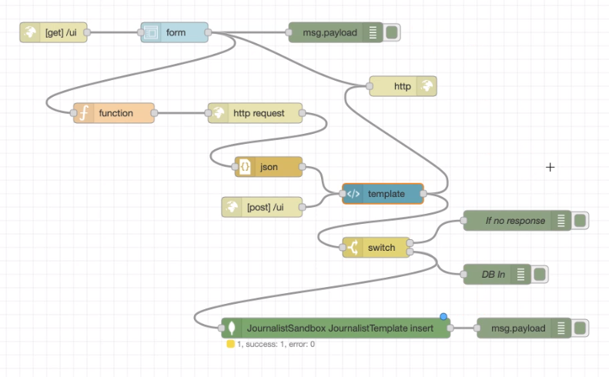
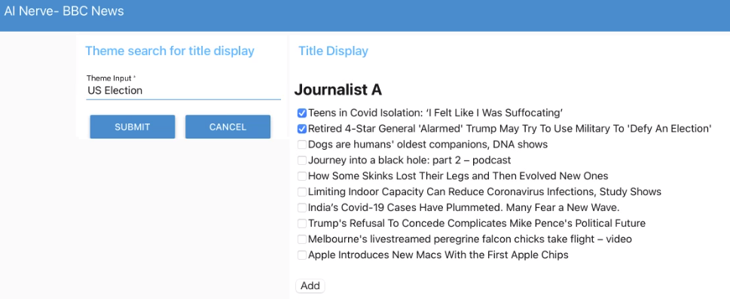
Journalist Topic Modelling
API from Article production is incorporated here to search for the keywords entered thru team input and bring topics on screen of Journalist to select them and pass on to Python snippet to get transformed into final Json structure for Content Template team.

Slide 9
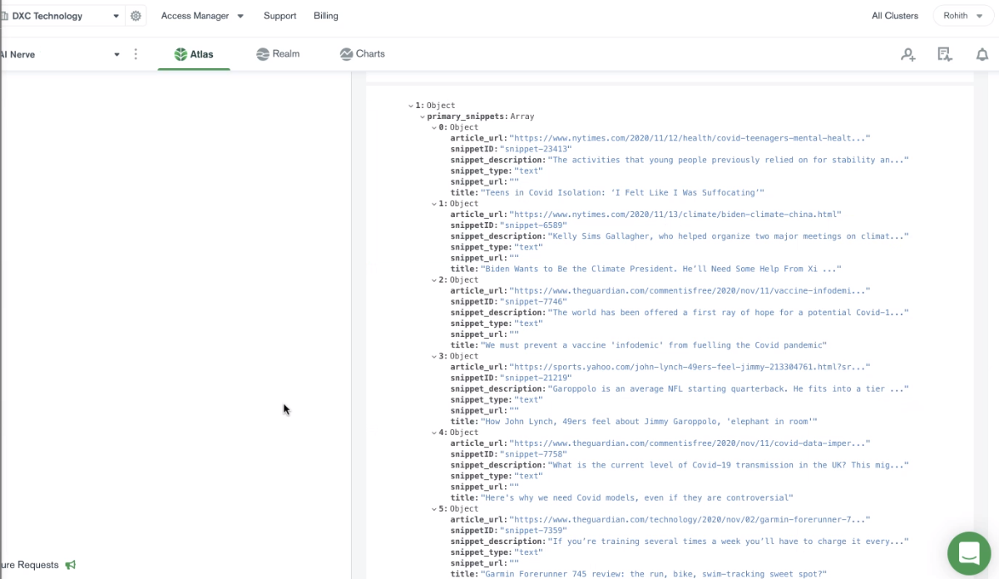
Journalist Topic Modelling (Contd.)

Slide 10
Future Work
Integration of all the individual workflows into one final story.
Fetching Primary and Secondary snippets.
Python logic to merge selected objects into final JSON structure of theme.json.
Python logic to merge selected objects into final JSON structure of topic_detail.json.
Approval and Reject system for review of Topics by Journalist.

Slide 11

Thankyou

